Slide 1
Roll the Dice: A Casino Number Guessing Game in C++
By ~
SANCHIT BANSAL (RA2211003012011)
MADHAV BAGRODIA (RA2211003012046) LUV GUPTA (RA2211003012047)

Slide 2
Contents
Introduction
The Rules of the Game
The Logic Behind the Code
Step-by-Step Process of Creating the Code
Conclusion

Slide 3
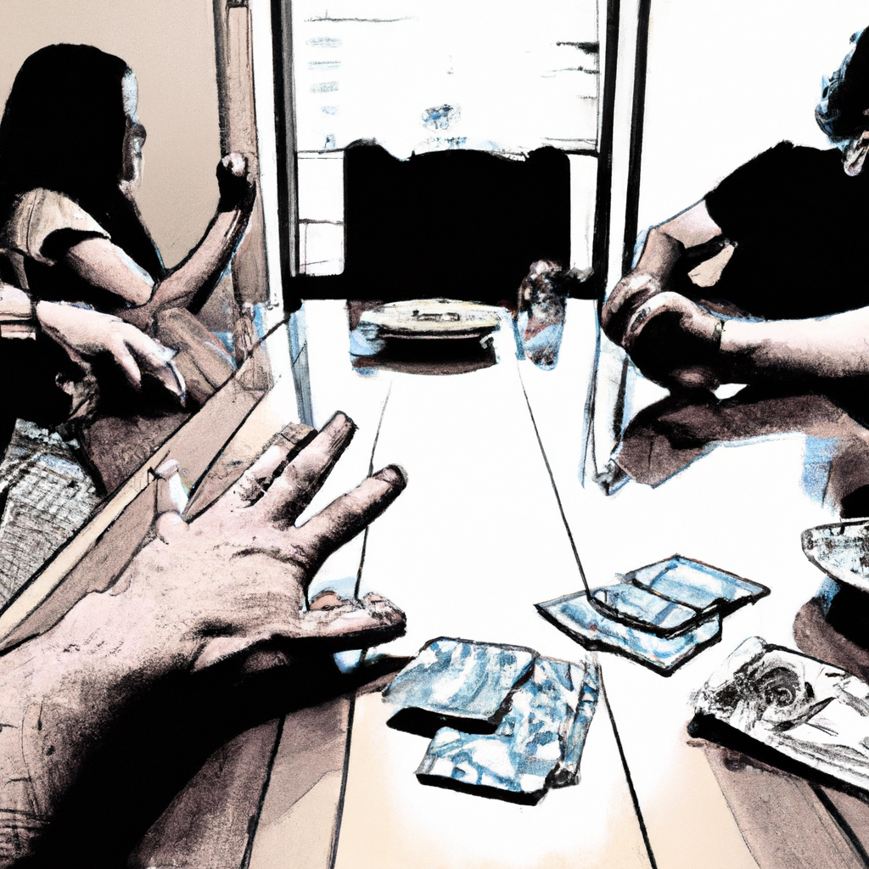
Introduction
The Casino Number Guessing Game is a popular game that involves guessing a random number between two given values. This game is often played in casinos and is enjoyed by many people around the world.
In this presentation, we will be discussing how to create a C++ code for the Casino Number Guessing Game. We will cover the basic rules of the game, the logic behind the code, and the step-by-step process of creating the code.

Slide 4

The Rules of the Game
Before we dive into the code, let's first discuss the basic rules of the Casino Number Guessing Game. The game begins with the player selecting a range of numbers between which the random number will be generated. For example, the player may choose a range between 1 and 100.
Once the range has been selected, the player must then guess the random number. The game will provide feedback on whether the guess was too high or too low, until the correct number is guessed. The player wins if they are able to correctly guess the number within a certain number of tries.

Slide 5
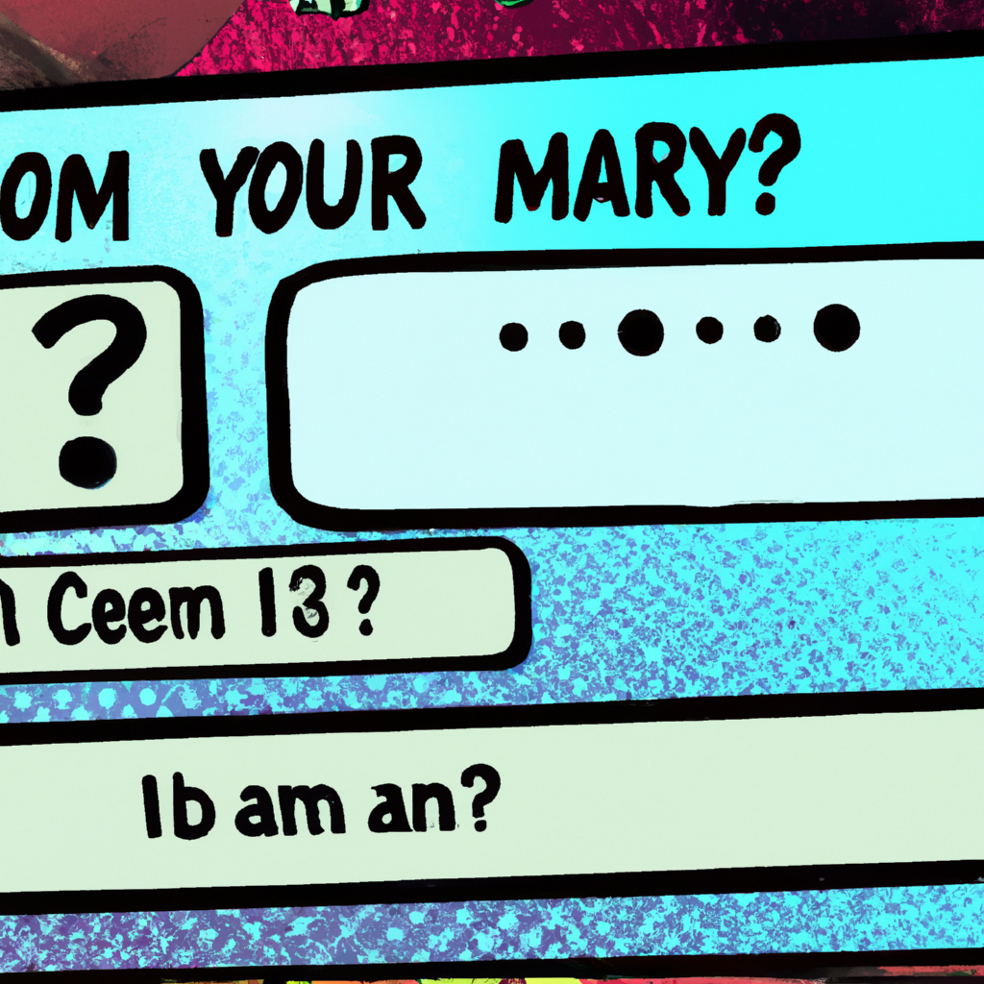
The Logic Behind the Code
Now that we understand the rules of the game, let's discuss the logic behind the code. The code will need to generate a random number within the selected range, and then prompt the user to make a guess.
If the user's guess is incorrect, the code will need to provide feedback on whether the guess was too high or too low, and prompt the user to make another guess. This process will continue until the user guesses the correct number or runs out of tries.

Slide 6

Step-by-Step Process of Creating the Code
Now that we understand the logic behind the code, let's go through the step-by-step process of creating it. First, we will need to include the necessary header files and define any necessary variables. We will then prompt the user to select a range of numbers.
Next, we will generate a random number within the selected range and prompt the user to make a guess. We will then use conditional statements to check if the guess is too high or too low, and prompt the user to make another guess. This process will continue until the user guesses the correct number or runs out of tries.

Slide 7
Source Code

Slide 8

Conclusion
In conclusion, the Casino Number Guessing Game is a fun and exciting game that can be easily created using C++ code. By following the step-by-step process outlined in this presentation, you can create your own version of the game and enjoy playing it with friends and family.
Remember to always test your code thoroughly and make any necessary adjustments before sharing it with others. With a little bit of practice, you'll be able to create complex games and programs using C++ code.

